Slide 1




PANEL DISCUSSION
SESSION TIME: 3:20 PM - 4:00 PM
CLIMATE RESILIENCE IN ROAD TRANSPORT AND SUSTAINABLE TECHNOLOGIES AND CONSTRUCTION MATERIALS

Slide 2
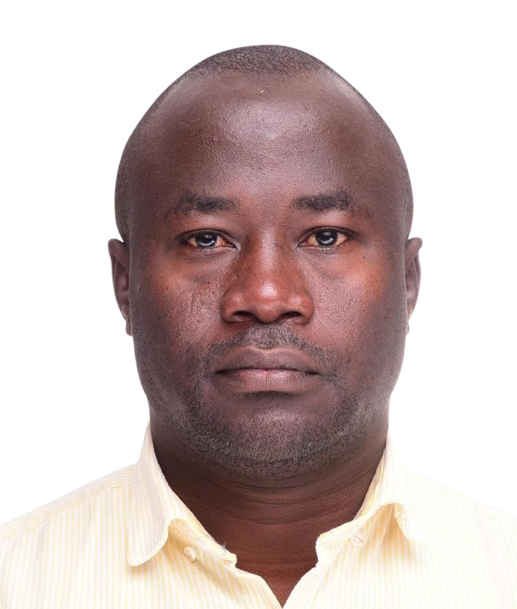
ENG. EPHRAIM OPUGE – SHORT PROFILE
  SPECIALIST IN SUSTAINABLE MOBILITY, TRANSPORT SYSTEMS, AND ROAD ENGINEERING WITH 18 YEARS' EXPERIENCE IN ROAD DESIGN, CONSTRUCTION, MAINTENANCE, AND ASSET MANAGEMENT
  ASSISTANT DIRECTOR OF ENGINEERING (ROADS), PLANNING AND ROAD MANAGEMENT DEPARTMENT – KENYA NATIONAL HIGHWAYS AUTHORITY (KENHA)
  LEADING THE DEVELOPMENT OF THE KENYA NATIONAL TRUNK ROADS 50-YEAR MASTER PLAN (KENTRO 2075)
  SPEARHEADING KENHA'S DIGITAL ROAD ASSET MANAGEMENT SYSTEMS (RAMS) TRANSFORMATION PROJECT AND NATIONWIDE ROAD AND BRIDGE INVENTORY SURVEYS
  MSC IN ROAD MANAGEMENT AND ENGINEERING – UNIVERSITY OF BIRMINGHAM, UK
  ADVANCED MEng STUDIES IN STRUCTURAL ENGINEERING – KYOTO UNIVERSITY, JAPAN AND UNIVERSITY OF NAIROBI
  RESEARCH FOCUSED ON SOCIAL EQUITY AND ACCESSIBILITY IN TRANSPORT – INCLUDING MOBILITY FOR PERSONS WITH DISABILITIES, WOMEN TRADERS, AND RURAL TRANSPORT USERS
KEY ACHIEVEMENTS
  18 YEARS OF PROFESSIONAL EXPERIENCE IN ROADS AND TRANSPORT ENGINEERING
  LEADERSHIP IN NATIONAL STRATEGIC ROAD PLANNING AND DIGITAL TRANSFORMATION AT KENHA
  DEVELOPMENT AND COORDINATION OF KENYA'S LONG-TERM TRUNK ROADS MASTER PLAN (KENTRO 2075)
  PUBLISHED RESEARCH ON INCLUSIVE AND EQUITABLE TRANSPORT SYSTEMS IN URBAN AND RURAL CONTEXTS
  PRESENTER AND PANELIST – 1ST KIHBT RESEARCH CONFERENCE
PANEL CHAIR
ENG. EPHRAIM OPUGE
ASSISTANT DIRECTOR OF ENGINEERING (ROADS) – KENHA

Slide 3
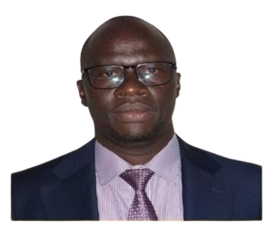
ENG. NDEGE – SHORT PROFILE
  CIVIL ENGINEER WITH OVER 17 YEARS' EXPERIENCE IN DESIGN, CONSTRUCTION, MAINTENANCE, AND PERFORMANCE MONITORING OF ROADS AND BRIDGES
  ACTING CHIEF ENGINEER (MATERIALS) – MATERIALS TESTING AND RESEARCH DIRECTORATE, STATE DEPARTMENT FOR ROADS, MINISTRY OF ROADS AND TRANSPORT
  EXTENSIVE EXPERIENCE IN PLANNING AND MANAGING CIVIL ENGINEERING PROGRAMMES AND SUPERVISING ROAD PROJECTS IN KENYA
  BSC CIVIL ENGINEERING AND MSC CIVIL ENGINEERING (TRANSPORTATION) – UNIVERSITY OF NAIROBI
  REGISTERED PROFESSIONAL ENGINEER – ENGINEERS BOARD OF KENYA (EBK)
  CORPORATE MEMBER – INSTITUTION OF ENGINEERS OF KENYA (MIEK)
KEY ACHIEVEMENTS
  OVER 17 YEARS OF PROFESSIONAL EXPERIENCE IN ROADS AND BRIDGES ENGINEERING
  LEADERSHIP IN MATERIALS TESTING AND RESEARCH AT NATIONAL LEVEL
  SUPERVISION OF MULTIPLE ROAD PROJECTS ACROSS KENYA
  DUAL QUALIFICATIONS IN CIVIL AND TRANSPORTATION ENGINEERING FROM THE UNIVERSITY OF NAIROBI
ENG. ALBERT O. NDEGE
ASSISTANT DIRECTOR OF ENGINEERING (ROADS) – KENHA

Slide 4
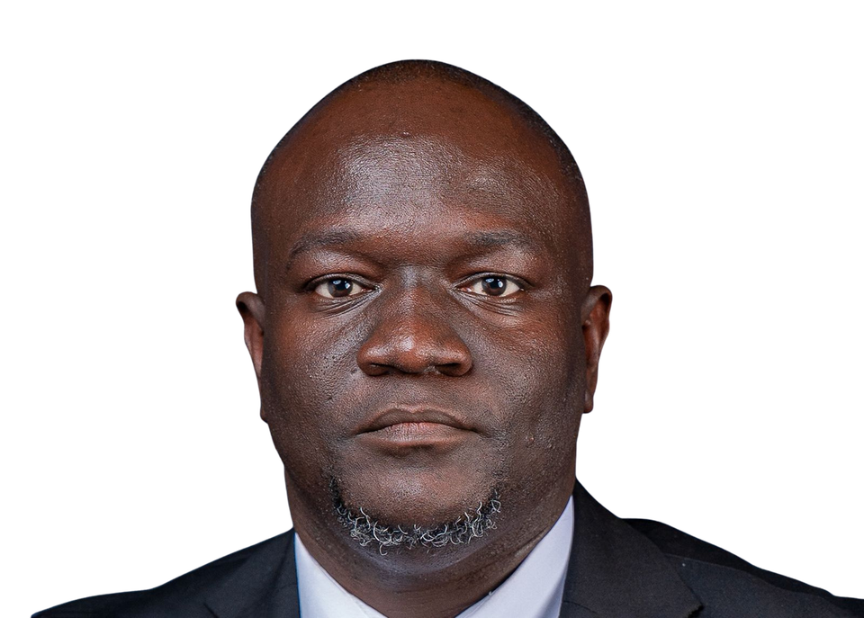
ENG. OGALLO – SHORT PROFILE
  GEOTECHNICAL AND PAVEMENT MATERIALS ENGINEER SPECIALIZING IN SUBSURFACE INVESTIGATIONS, FOUNDATION DESIGN, PAVEMENT ENGINEERING, AND CONSTRUCTION QUALITY ASSURANCE
  MANAGING DIRECTOR, NOITECH ENGINEERING LIMITED – LEADING GEOTECHNICAL INVESTIGATIONS AND INFRASTRUCTURE ADVISORY ACROSS KENYA AND THE REGION; DELIVERED OVER 600 KM OF ROAD CORRIDORS AND MAJOR HOUSING, MARINE, AND ENERGY PROJECTS
  BSC CIVIL ENGINEERING – JKUAT; PURSUING MSC GEOTECHNICAL ENGINEERING – DeKUT; CERTIFIED IN ESIA, CLIMATE CHANGE, NON-DESTRUCTIVE TESTING, AND ADVANCED GEOTECHNICAL PRACTICE
  REGISTRAR (ENGINEERS CHAPTER) – ARCHITECTURAL ASSOCIATION OF KENYA (AAK); HONORARY SECRETARY – KENYA GEOTECHNICAL SOCIETY
  IEK-NOMINATED PROFESSIONAL ADVISORY ENGINEER TO NAIROBI CITY COUNTY; COUNTY REPRESENTATIVE FOR KISUMU – IEK NYANZA BRANCH
  ASSOCIATE CONSULTANT, ESAMI UNDER THE TANROADS PROGRAMME (TANZANIA); CONTRIBUTOR TO KEBS GEOTECHNICS TECHNICAL COMMITTEE ON NATIONAL STANDARDS DEVELOPMENT
KEY ACHIEVEMENTS
  DELIVERY OF OVER 600 KM OF ROAD CORRIDORS AND DIVERSE INFRASTRUCTURE PROJECTS ACROSS EAST AFRICA
  LEADERSHIP IN GEOTECHNICAL PRACTICE ACROSS ROADS, BRIDGES, DAMS, PORTS, AND HIGH-RISE DEVELOPMENTS
  ACTIVE ROLES IN PROFESSIONAL GOVERNANCE AT AAK, IEK, KENYA GEOTECHNICAL SOCIETY, AND ACEK
  CONTRIBUTION TO NATIONAL STANDARDS THROUGH KEBS AND CAPACITY BUILDING IN CONSTRUCTION MATERIALS LABORATORIES
  MENTORSHIP AND YOUTH EMPOWERMENT THROUGH COMMUNITY AND PROFESSIONAL DEVELOPMENT INITIATIVES
ENG. JOHN ROBERT OTIENO OGALLO
MANAGING DIRECTOR, NOITECH ENGINEERING LIMITED

Slide 5
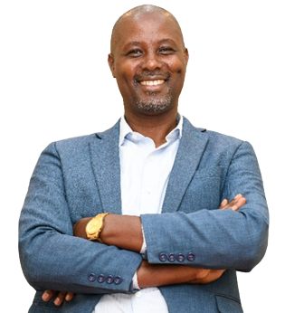
DR. NICHOLAS KUNGA NGECE – SHORT PROFILE
  DEPUTY DIRECTOR, ENVIRONMENT, SOCIAL SAFEGUARDS AND SUSTAINABILITY – KENYA RURAL ROADS AUTHORITY (KeRRA), NAIROBI
  FORMER CECM FOR HEALTH AND SANITATION AND CCO FOR ENVIRONMENT, NATURAL RESOURCES AND CLIMATE CHANGE – EMBU COUNTY GOVERNMENT; SET UP DONOR-FUNDED PROGRAMMES IN CLIMATE, NRM, AND WASTE MANAGEMENT
  EXTENSIVE INTERNATIONAL CAREER SPANNING SIDA (REGIONAL PROGRAMMES MANAGER), WWF (REGIONAL MANAGER), IUCN (PROGRAMME MANAGER), CARBON ZERO BALANCE UK (REGIONAL COORDINATOR), AND IIRR AFRICA AND DETRA-AFRICA (DIRECTOR)
  CONVENER AND COORDINATOR – SUSTAINABILITY IMPACT NETWORK AFRICA (SUSINA), A PAN-AFRICAN PLATFORM PROMOTING CLIMATE, ENVIRONMENTAL, ECONOMIC, AND SOCIAL SUSTAINABILITY INNOVATIONS
  PHD IN ENVIRONMENTAL ECONOMICS – SWISS MANAGEMENT CENTRE UNIVERSITY, SWITZERLAND
  MSC – UNIVERSITY OF NAIROBI; BSC IN NATURAL RESOURCES MANAGEMENT – EGERTON UNIVERSITY
  FINALIZING A SECOND PHD IN MANAGEMENT AND LEADERSHIP – MANAGEMENT UNIVERSITY OF AFRICA
KEY ACHIEVEMENTS
  SENIOR LEADERSHIP ROLES ACROSS GOVERNMENT, INTERNATIONAL NGOs, AND PRIVATE SECTOR IN ENVIRONMENT AND SUSTAINABILITY
  ESTABLISHMENT OF DONOR-FUNDED CLIMATE AND NRM PROGRAMMES AT COUNTY GOVERNMENT LEVEL
  FOUNDING AND COORDINATION OF SUSINA – A PREMIER AFRICAN SUSTAINABILITY AND IMPACT NETWORK
  DUAL PHD QUALIFICATIONS IN ENVIRONMENTAL ECONOMICS AND MANAGEMENT AND LEADERSHIP
  MULTI-SECTOR EXPERTISE SPANNING CLIMATE CHANGE, ENVIRONMENTAL POLICY, SOCIAL SAFEGUARDS, AND SUSTAINABLE DEVELOPMENT
DR. NGECE NICHOLAS KUNGA
DEPUTY DIRECTOR, ENVIRONMENT, SOCIAL SAFEGUARDS AND SUSTAINABILITY, KENYA RURAL ROADS AUTHORITY (KERRA)

Slide 6
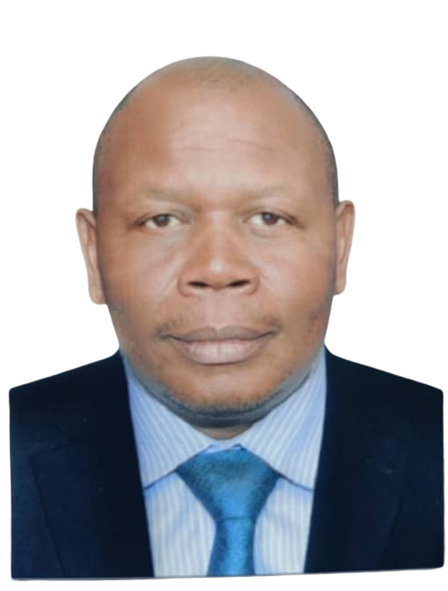
ENG. EMMANUEL TWINAMATSIKO – SHORT PROFILE
  UGANDAN CIVIL ENGINEER WITH 25 YEARS OF PROFESSIONAL EXPERIENCE IN ROADS DEVELOPMENT, MANAGEMENT, AND MAINTENANCE
  ASSISTANT COMMISSIONER, DISTRICT AND COMMUNITY ACCESS ROADS – MINISTRY OF WORKS AND TRANSPORT, UGANDA; RESPONSIBLE FOR POLICY FORMULATION, STRATEGIC PLANNING, AND MONITORING OF RURAL ROADS PROGRAMMES
  14 YEARS IN LOCAL GOVERNMENT AND 11 YEARS IN CENTRAL GOVERNMENT MANAGING RURAL ROADS PROGRAMMES INCLUDING DISTRICT, URBAN, AND COMMUNITY ACCESS ROADS
  PROVIDES OVERSIGHT AND CAPACITY BUILDING TO LOCAL GOVERNMENTS IN DEVELOPMENT AND MANAGEMENT OF RURAL ROADS
  BSC CIVIL ENGINEERING – MAKERERE UNIVERSITY, UGANDA
  MSC WATER SCIENCE AND ENGINEERING – IHE DELFT, NETHERLANDS
  MBA – EASTERN AND SOUTHERN AFRICAN MANAGEMENT INSTITUTE (ESAMI)
KEY ACHIEVEMENTS
  25 YEARS OF ENGINEERING PRACTICE SPANNING LOCAL AND CENTRAL GOVERNMENT IN UGANDA
  LEADERSHIP IN POLICY FORMULATION AND IMPLEMENTATION OF NATIONAL RURAL ROADS PROGRAMMES
  SUPERVISION OF CONVENTIONAL AND INNOVATIVE ROAD CONSTRUCTION AND MAINTENANCE PROJECTS
  CAPACITY BUILDING OF LOCAL GOVERNMENTS IN RURAL ROADS DEVELOPMENT AND MANAGEMENT
  COMMITMENT TO REGIONAL KNOWLEDGE SHARING TO ADVANCE ROAD NETWORK CONNECTIVITY ACROSS AFRICA
ENG. EMMANUEL TWINEMATSIKO
ASSISTANT COMMISSIONER, DISTRICT AND COMMUNITY ACCESS ROADS, MINISTRY OF WORKS AND TRANSPORT, UGANDA

Slide 7
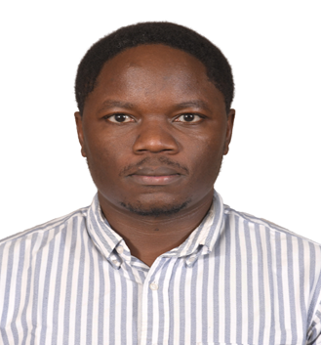
ENG. ABUODHA CHARLES – SHORT PROFILE
  ROADS AND BRIDGES ENGINEER AT THE KENYA RURAL ROADS AUTHORITY (KERRA) HQ, NAIROBI; SERVING AS ENGINEER ROADS DEVELOPMENT AND RESIDENT ENGINEER
  EXTENSIVE EXPERIENCE IN DESIGN OF ROAD AND DRAINAGE STRUCTURES ACROSS KENYA
  SPECIALIST IN BRIDGE ENGINEERING, BOX CULVERT DESIGN, CONSTRUCTION MANAGEMENT, AND CONTRACT ADMINISTRATION
  REGISTERED PROFESSIONAL ENGINEER – ENGINEERS BOARD OF KENYA (EBK)
  CORPORATE MEMBER – INSTITUTION OF ENGINEERS OF KENYA (MIEK)
  BSC CIVIL AND CONSTRUCTION ENGINEERING – UNIVERSITY OF NAIROBI
  FINALIZING MSC IN STRUCTURAL ENGINEERING – UNIVERSITY OF NAIROBI
KEY ACHIEVEMENTS
  SIGNIFICANT CONTRIBUTION TO KENYA'S TRANSPORT INFRASTRUCTURE THROUGH ROADS AND BRIDGE ENGINEERING
  EXPERTISE IN INNOVATIVE ENGINEERING SOLUTIONS FOR ROAD AND DRAINAGE STRUCTURE DESIGN
  EFFECTIVE PROJECT DELIVERY THROUGH STRONG CONSTRUCTION MANAGEMENT AND CONTRACT ADMINISTRATION
  DUAL QUALIFICATIONS IN CIVIL AND STRUCTURAL ENGINEERING FROM THE UNIVERSITY OF NAIROBI
ENG. ABUODHA CHARLES
ENGINEER (ROADS) DEVELOPMENT, KENYA RURAL ROADS AUTHORITY (KERRA)

Slide 8
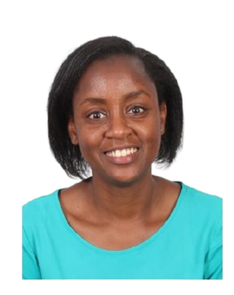
ENG. GLADWELL NG'ANG'A – SHORT PROFILE
  SENIOR ENGINEER (MATERIALS) – MATERIALS TESTING AND RESEARCH DIRECTORATE (MTRD), STATE DEPARTMENT FOR ROADS; SPECIALIST IN CONCRETE USE IN CONSTRUCTION AND RESEARCH
  REGISTERED PROFESSIONAL ENGINEER – ENGINEERS BOARD OF KENYA (EBK)
  CORPORATE MEMBER – INSTITUTION OF ENGINEERS OF KENYA (MIEK)
  CURRENTLY PURSUING PHD (PART-TIME) – UNIVERSITY OF NAIROBI
  AUTHOR OF SEVERAL PEER-REVIEWED JOURNAL AND CONFERENCE PAPERS IN CONSTRUCTION MATERIALS
  MSC – UNIVERSITY OF CAPE TOWN, SOUTH AFRICA
  BSC CIVIL AND CONSTRUCTION ENGINEERING – UNIVERSITY OF NAIROBI
KEY ACHIEVEMENTS
  TECHNICAL EXPERTISE IN MATERIALS TESTING, RESEARCH, AND CONCRETE ENGINEERING AT NATIONAL LEVEL
  PUBLISHED RESEARCH IN PEER-REVIEWED JOURNALS AND CONFERENCES IN CONSTRUCTION MATERIALS
  INTERNATIONAL ACADEMIC TRAINING FROM THE UNIVERSITY OF CAPE TOWN
  ACTIVE CONTRIBUTION TO ROADS SECTOR MATERIALS RESEARCH THROUGH MTRD
ENG GLADWELL NG’ANG’A
SENIOR ENGINEER - MATERIALS AT MATERIALS TESTING AND RESEARCH DIRECTORATE (MTRD)

Slide 9
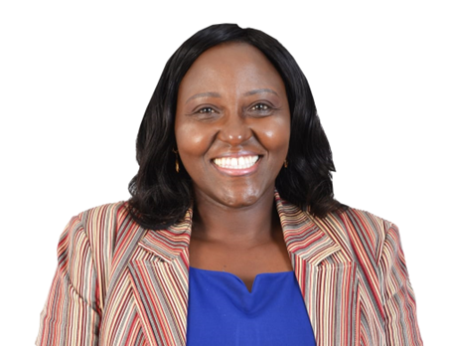
ENG. JACINTA MWANGI – SHORT PROFILE
  INFRASTRUCTURE AND POLICY LEADER WITH OVER 20 YEARS' EXPERIENCE IN URBAN ROADS DEVELOPMENT, INSTITUTIONAL GOVERNANCE, AND EVIDENCE-BASED POLICY REFORM
  DIRECTOR, POLICY STRATEGY AND COMPLIANCE – KURA; LEADS STRATEGIC PLANNING, PERFORMANCE CONTRACTING, RISK MANAGEMENT, RESEARCH AND INNOVATION, AND QUALITY ASSURANCE FRAMEWORKS
  PRIOR ROLES AT KURA INCLUDE REGIONAL DIRECTOR AND HEAD OF URBAN ROADS AND PLANNING
  CHAMPION OF CLIMATE-RESILIENT INFRASTRUCTURE INCLUDING THE NAIROBI INTELLIGENT TRANSPORT SYSTEMS (ITS) PROJECT AND BUS RAPID TRANSIT (BRT) LINE 5
  REGISTERED CIVIL ENGINEER AND CORPORATE MEMBER – INSTITUTION OF ENGINEERS OF KENYA (MIEK); HONORARY MEMBER – KENYA INSTITUTE OF PLANNERS
  BSC CIVIL ENGINEERING – JKUAT; MBA – KENYATTA UNIVERSITY
KEY ACHIEVEMENTS
  OVER 20 YEARS OF LEADERSHIP IN KENYA'S URBAN ROADS AND TRANSPORT POLICY SECTOR
  POSITIONING KURA AS A KNOWLEDGE-DRIVEN INSTITUTION AT THE FOREFRONT OF URBAN MOBILITY
  LEADERSHIP IN DELIVERY OF NAIROBI ITS PROJECT AND BRT LINE 5
  TRANSLATION OF RESEARCH AND INNOVATION INTO TRANSFORMATIVE URBAN INFRASTRUCTURE POLICY
  CROSS-DISCIPLINARY RECOGNITION AS HONORARY MEMBER OF THE KENYA INSTITUTE OF PLANNERS
ENG. JACINTA MWANGI
DIRECTOR POLICY STRATEGY AND COMPLIANCE, KENYA URBAN ROADS AUTHORITY (KURA)

Slide 10


THANK
YOU

